Slide 1



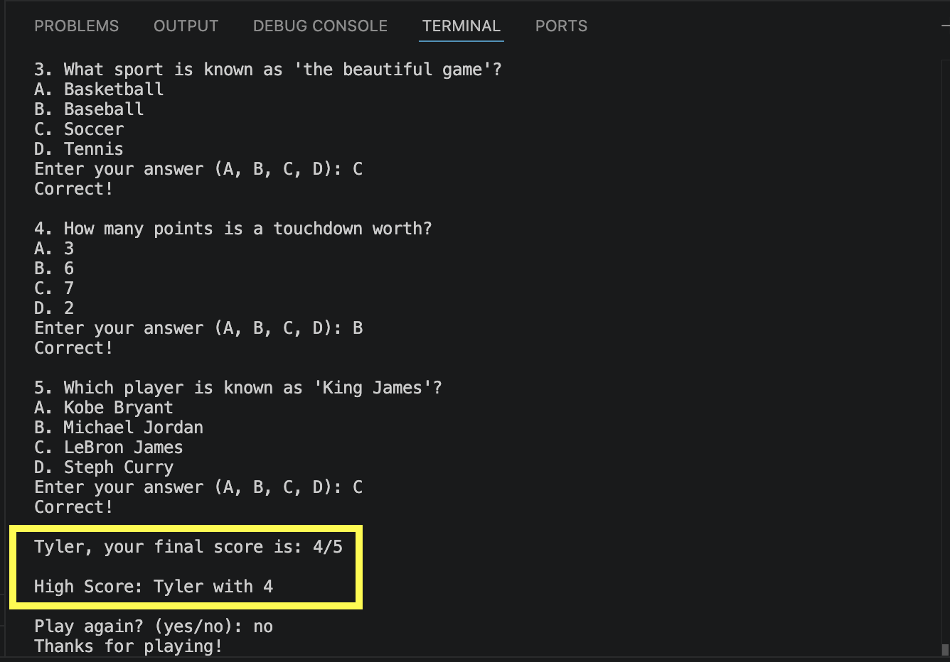
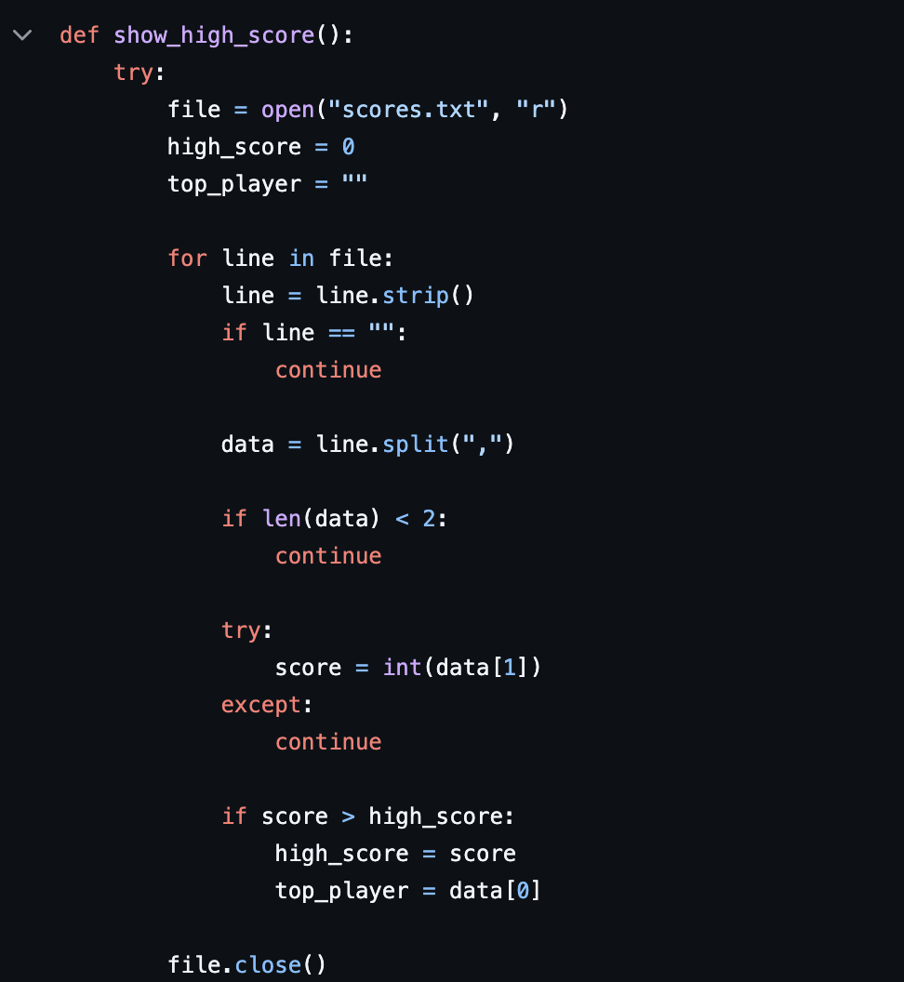
Ultimate Sports Quiz Challenge
Multiple-choice sports trivia game
Tracks user score in real time
Saves high scores using file handling
Allows users to replay and improve
A fun, interactive Python quiz game that tests sports knowledge and tracks high scores.
By: Tyler George
The Result!

